Slide 1
Monopolistic Competition
Reference. Pindyck & Rubinefeld
J. Tirole

Slide 2
Monopolistic Competition
● Market in which firms can enter freely, each producing its own brand or version of a differentiated product.
Differentiated product;
Close substitutes so that elasticities are high;
Free entry & exit.

Slide 3
The Makings of Monopolistic Competition
A monopolistically competitive market has two key characteristics:
1. Firms compete by selling differentiated products that are highly substitutable for one another but not perfect substitutes. In other words, the cross-price elasticities of demand are large but not infinite.
2. There is free entry and exit: it is relatively easy for new firms to enter the market with their own brands and for existing firms to leave if their products become unprofitable.

Slide 4

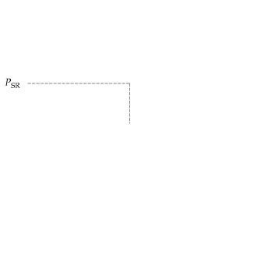
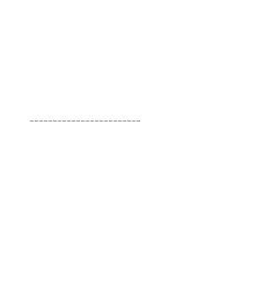
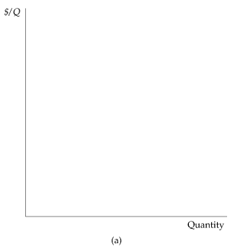
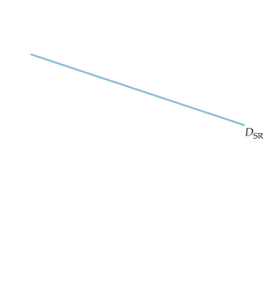
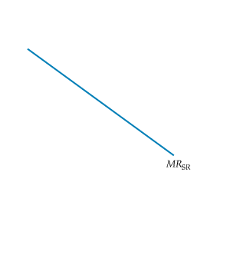
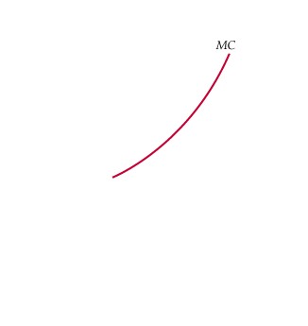
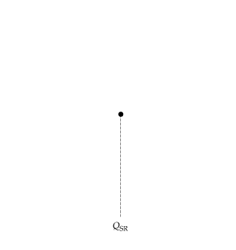
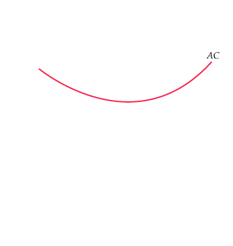
MONOPOLISTIC COMPETITION
A Monopolistically Competitive Firm in the Short and Long Run
Because the firm is the only producer of its brand, it faces a downward-sloping demand curve.
Price exceeds marginal cost and the firm has monopoly power.
In the short run, described in part (a), price also exceeds average cost, and the firm earns profits shown by the yellow-shaded rectangle.

Slide 5
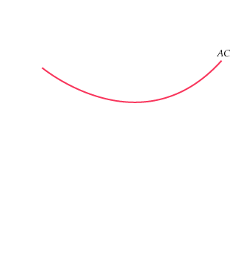
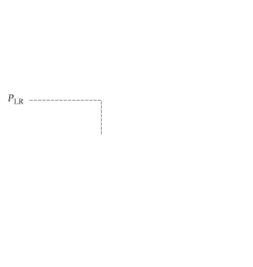
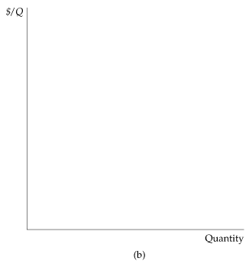
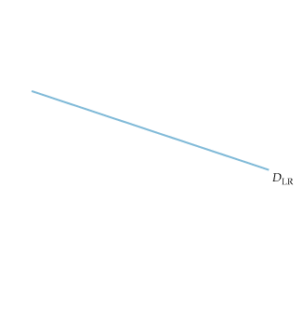
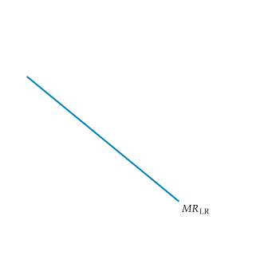
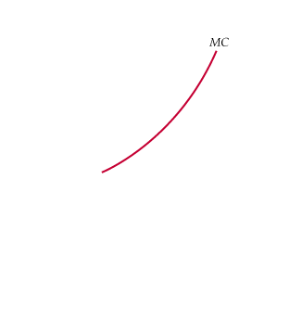
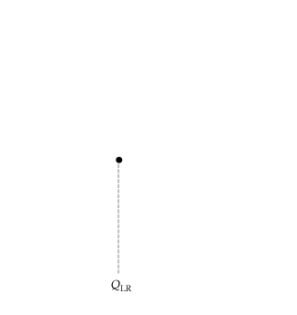
Equilibrium in the Short Run and the Long Run
In the long run, these profits attract new firms with competing brands. The firm’s market share falls, and its demand curve shifts downward.
In long-run equilibrium, described in part (b), price equals average cost, so the firm earns zero profit even though it has monopoly power.

Slide 6
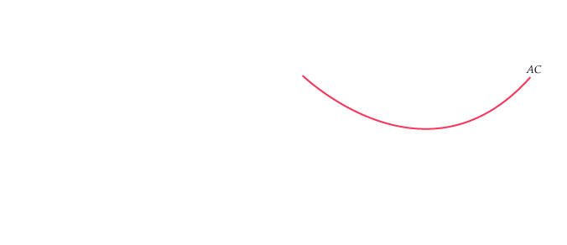

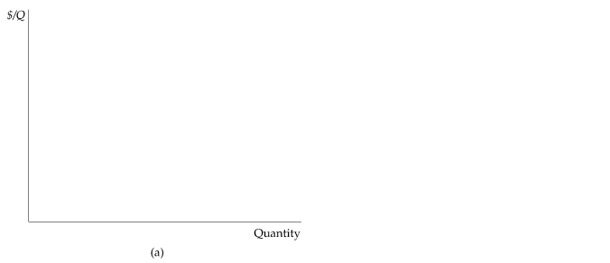
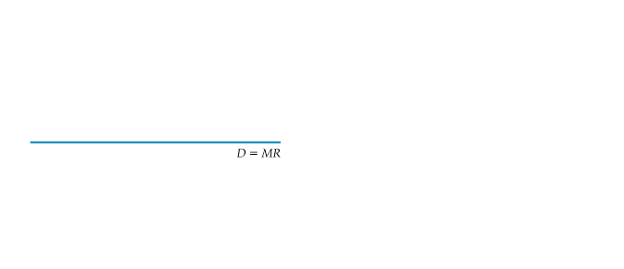
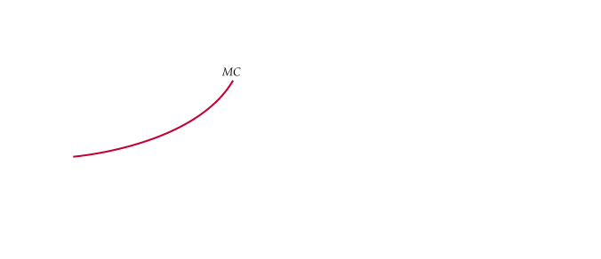
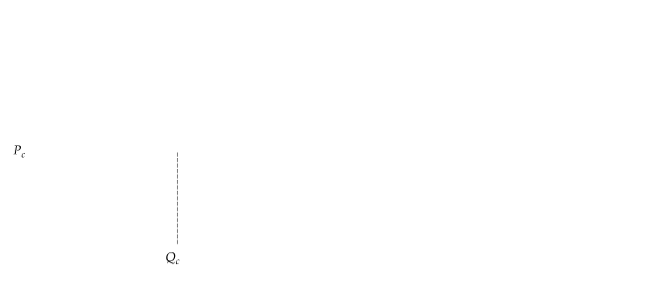

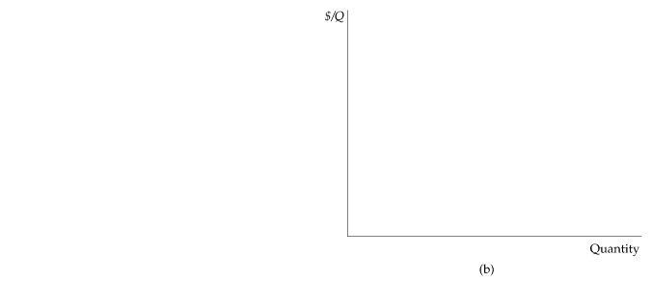
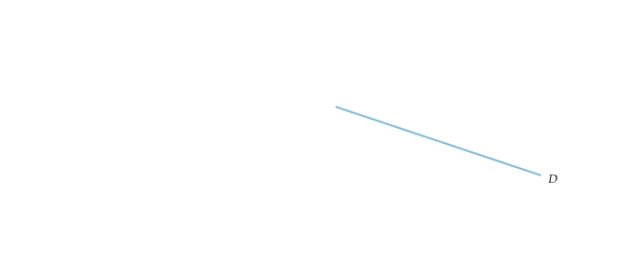
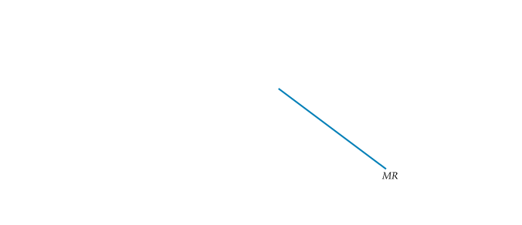
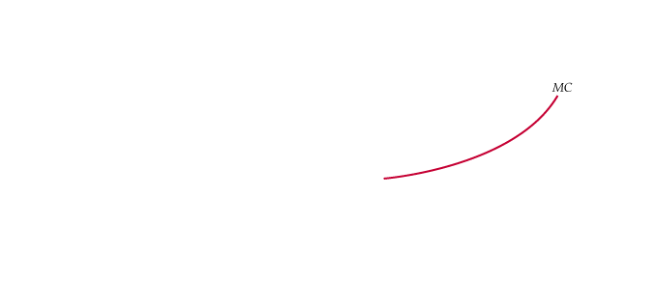
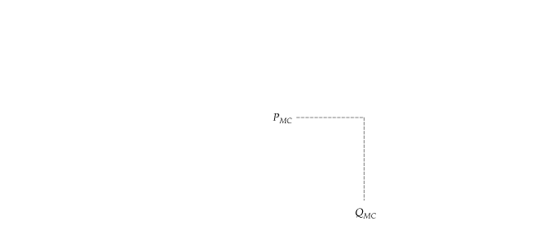
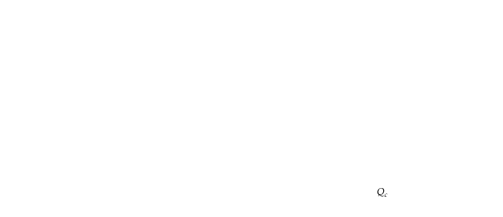
MONOPOLISTIC COMPETITION
Monopolistic Competition and Economic Efficiency
Comparison of Monopolistically Competitive Equilibrium and Perfectly Competitive Equilibrium
Under monopolistic competition, price exceeds marginal cost.
Thus there is a deadweight loss, as shown by the yellow-shaded area.
The demand curve is downward-sloping, so the zero-profit point is to the left of the point of minimum average cost.
In both types of markets, entry occurs until profits are driven to zero.
In evaluating monopolistic competition, these inefficiencies must be balanced against the gains to consumers from product diversity.

